Slide 1
What are Ideas?
Student Power Point
for explaining IDEAS in Write Traits
Hill, 2009

Slide 2
Ideas!
Ideas are the heart of the message, the content of the piece, the main theme, together with rich details.
When teachers look for qualities in writing, focusing in on ideas, they look for clarity, focus, good information, a fresh perspective, and important, helpful details that go beyond the obvious.

Slide 3
Ideas!
When we work with our ideas, a good process for getting them out is:
Select an idea (the topic – sometimes assigned, sometimes not)
Narrow the idea (focus)
Elaborate the idea (development)
Discover the best information to convey the main idea (details)

Slide 4
How we grade IDEAS!
6- The ideas are crystal clear. They are easily understood. There are interesting details.
5- The writing makes sense from beginning to end. There are important details that help explain ideas.
4- Most of the paper is clear and focused. There are some details, but more would be helpful.
3- Some of the ideas are hard to understand. There are very few details.
2- This is confusing. I’m not sure what is being said.
1- What? This looks more like notes.

Slide 5
Questions? Comments? Concerns?
Now it’s your turn to start generating some ideas!

Slide 6
Generating Ideas
The easiest (and most efficient) way to come up with ideas is to use a brainstorm organizer. I like to call mine cluster maps.
Details Details
Details Details
Details
Topic

Slide 7
Generating Ideas
After you’ve come up with your details, you can add details to those details or take away unnecessary information.
Cold-blooded Live in swamps
Amphibian Eat flies
Moist skin
Frogs

Slide 8
Generating Ideas
You’ve got a ton of ideas in your head. Sometimes we think we don’t know what to write about, but really we’re just having a hard time holding down one idea. So, the organizer will help you. Let’s try with this topic. Make a brainstorm organizer for this idea (add as many details as possible….right now just list, we’ll put them into detailed sentences later):

Slide 9
Topic:
SHOE

Slide 10
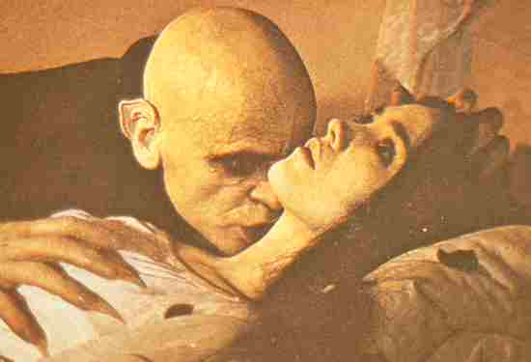
Topic:
VAMPIRE

Slide 11

Topic:
FIRE

Slide 12
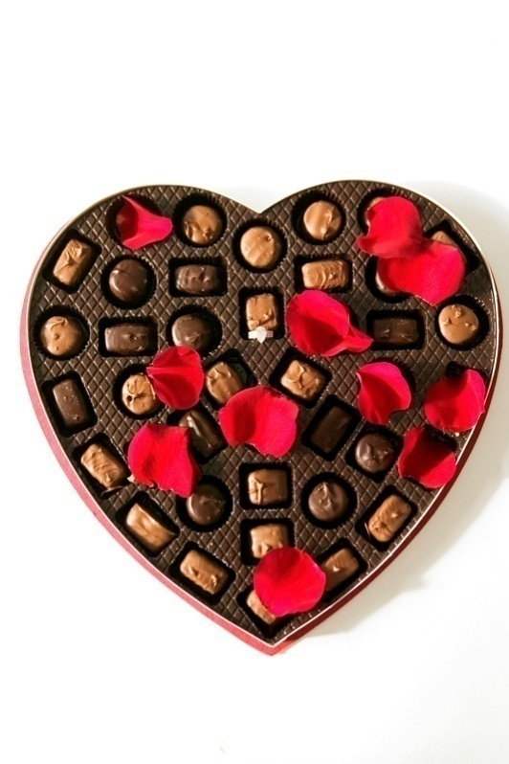
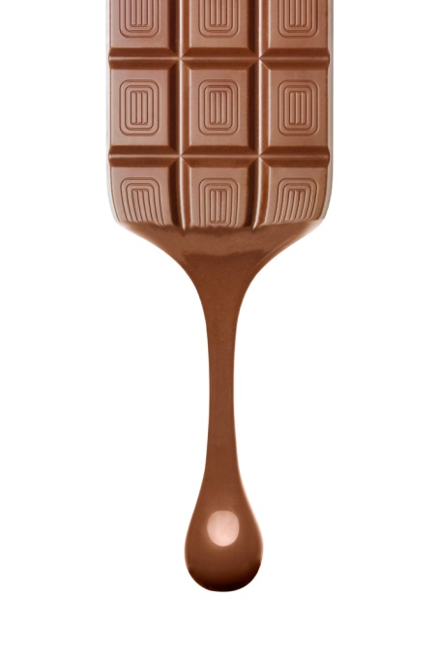
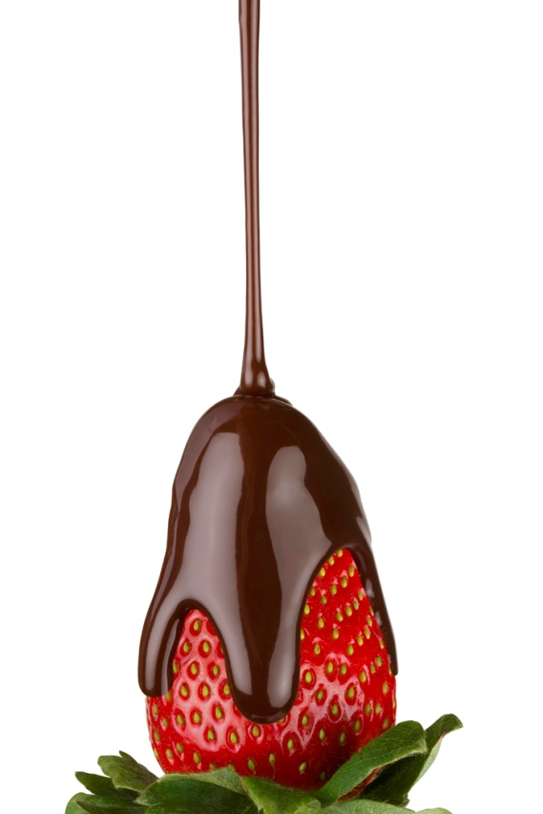
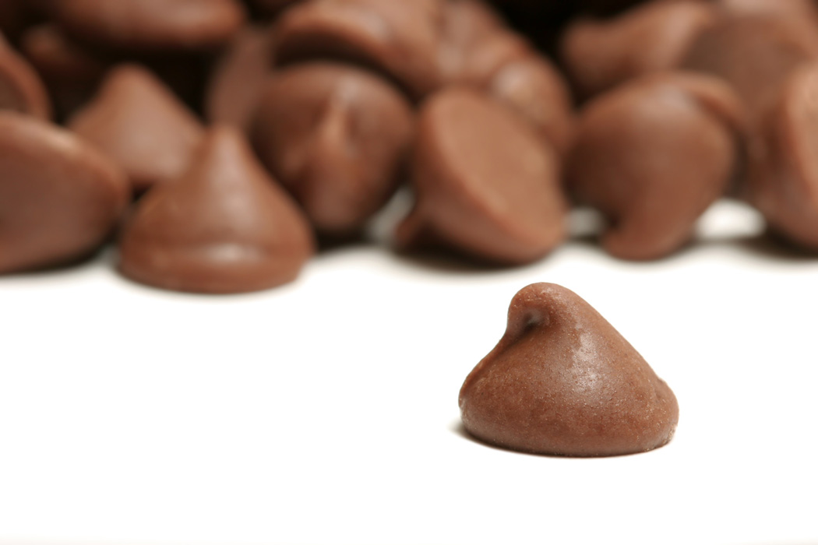
Topic:
CHOCOLATE

Slide 13
Great job!
Now we’re going to do an activity called “Picture This.”
You are going to find a picture from a magazine. It should be interesting (food, an interesting or unusual object, a person, etc.)
You are going to brainstorm ideas and details about this picture
Using as much detail, “SHOW” you readers what’s happening in the picture. Use strong details and descriptions so that your readers can see what you see (even if they’re not looking at the picture).

Slide 14
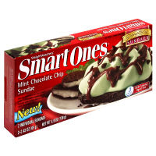

Example:
Mmmm….scrumptious. This delectable little dessert will make your mouth water and your eyes grow wide with anticipation as you wait to take your very first creamy, minty bite. As the cool spoon edges closer to your mouth, you can already smell the incredibly light, minty goodness of the soft, cool cream. Once it touches your lips, you feel as though you are in heaven, bouncing on little clouds of sweet sugar. This mountain of heaping mint cream is drizzled with just the right amount of chocolatey-river syrup, cascading down each tiny peak. You will never want to leave this moment…for it’s heaven on a plate!

Slide 15
Ideas
You’ve become more familiar with generating ideas (yes, you’ve got lots of them just from your own life experiences), and now we’re going to get more specific.
This activity helps us generate ideas and really get specific so that we can SHOW rather than tell when sharing an idea or story.

Slide 16
Ideas
Directions:
Write down in your Writer’s Notebook as many reasons as you can think of for why people lie.
Now think of as many different times that you have lied as you can. Try to be very specific. The more you remember, the easier the next step will be. Don't worry...no one here is going to tell on you! (Use a brainstorm organizer for this one, like a cluster map)
Pick the most interesting of your own lies and circle it. Brainstorm everything you can about that lie. How old were you? Who did you lie to? What did you lie about? Why did you lie? What reason did you use? Did you lie to save yourself from a punishment? To get out of going to school? To protect someone else? Did you ever get caught? Should you tell the truth now? Why or why not?
Put this lie (from how it all started to how it ended) onto a timeline (step by step, in order, from start to finish)
Now take the information from your timeline, put the ideas into complete sentences, and add details to show your reader what happened from start to finish (let your reader feel as though she/he is standing right there with you).

Slide 17

Ideas
Have you ever been hurt and needed a Band-Aid or just a hug? Did you fall off a bike or fence or horse, or did you try to fly...only to find the landing left you a little wounded? Let's see how well you remember your own experience. Have your Writer’s Notebook and a pencil or pen?

Slide 18
Ideas
Brainstorm or list times you were hurt in any type of accident.
Pick the time that you have the strongest feelings for.
Now brainstorm just the one time you've chosen, but try to remember the pain, who was there, where it happened, when it happened, what happened, why it happened. Did it require a hospital visit?
Using as much detail as possible, SHOW your readers what happened. Make your readers feel as though they are standing right there with you in the scene and feeling your pain.

Slide 19
Ideas
Inspired by the book WALTER THE FARTING DOG
For this activity, you will choose an ordinary animal to write about. Choose an animal from the left list. Then, from the right list, choose a problem this animal has.
After choosing your animal and problem you are on your way to a silly and fun story. Don’t forget to include wonderful details when writing about the situations your animal gets itself into with its silly and extraordinary problem.
ANIMAL PROBLEM
Horse Too sad
Goat Too short
Cheetah Too jumpy
Lizard Too tall
Rat Too scared
Monkey Too loud
Leopard Too strong
Koala Too furry

Slide 20
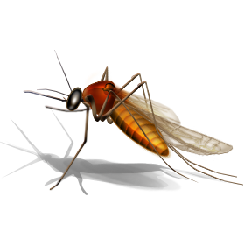
Example:
MOSQUITO
You have no idea what it’s like. Well, let me tell you right now that it’s terrible! No one understands my pain! See, I’m a mosquito. My problem: I don’t like drinking blood! Now, I know what you’re thinking…mosquitoes are supposed to be annoying, buzzing around, biting people, sucking out their blood, and then leaving itchy little bumps all over human bodies. Well, I just don’t like blood. It’s way too thick, and I’ve never really been a fan of the color red. It’s like trying to drink a thick, warm milk shake. Yuck! Also, I don’t like people trying to swat at me all the time, thinking that I’m a nuisance. I’m not; in fact, I’m a pretty nice girl once you get to know me. How would you like people trying to smack you between their two enormous hands every time they see you? So, how about we make a deal: I’ll leave you alone and I won’t try to suck your blood. In return, you need to stop trying to kill me! Deal? Thanks!

Slide 21
Ideas!
Can you create an interesting piece of writing for this title?
Monkeys Live Next Door To Me Ghosts, Ghosts, Ghosts
Dandelion Season A Dream Come True
Dancing in the Fountain Rocket from Infinity
The House without a Window The Worst Magic Trick Ever
The Puppy Who Liked Being Lost Bulldozer in the Kitchen
Spaceship from the Backyard The Annoying Best Friend
The Stinky Toothbrush The People with Wings

Slide 22
Other Ideas…
Write about yourself with the following topic (remember to brainstorm first):
I am a bad friend.
I am a mediocre team mate.
I am an excellent student.
I am a kind sibling.

Slide 23
Here’s A Student Example:
Grown up rule: Turn off the lights!
Reason: Save electricity and money.
THE TRUTH: The real reason your parents tell you to turn off the lights is because in every light bulb there are millions of microscopic bulb lizards. If you leave the light on, these intelligent creatures can melt right through the outside of the light bulb. There are two kinds of bulb lizards. One of them is called the lost lizard. They are known to hide all of your toys in their special hiding spots call the “special box.” They carry the key wherever they go. When you go to tell your mom or dad that you can’t find your special toy and that you have looked everywhere, your parent goes and finds the lost lizard, get the key, gets your toy out, and puts it in a very obvious spot. This makes it seem like you are blind or didn’t look hard enough for your special toy.

