Slide 1
Dramatic/Plot Structure
Please copy the following information in your Literature Learning Log on how to complete a dramatic/plot structure

Slide 2
Plot Structure
climax constitutes:
the turning point of the story
crisis point or point of greatest tension
at the resolution:
the main conflict is resolved
protagonist is involved in the resolution
during the rising action:
the main conflict is introduced
Plot development/Level of tension
In the exposition:
setting is given
main characters are introduced
basic info given to understand the plot
during the falling action:
minor plot developments are resolved
Time
exposition
rising action
climax
falling action
resolution

Slide 3
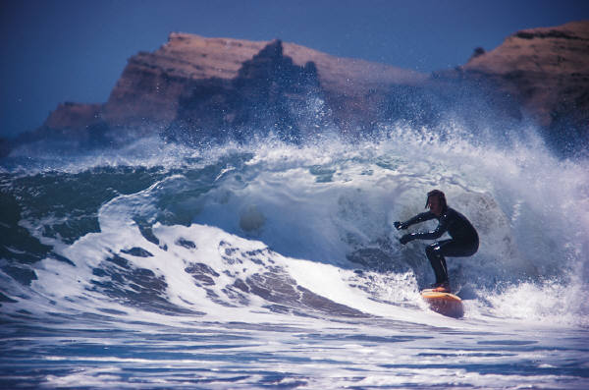
Exposition
Setting:
Where = geographic location
When = date, season, time period
Why = situation in which the story is set (context)
Main Characters:
Protagonist: Name
Antagonist: Name
Basic Plot: Describe in 10 words or less.

Slide 4
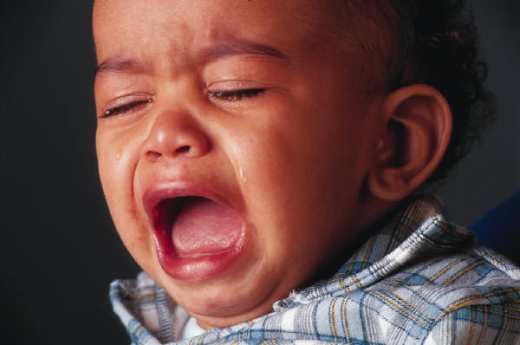
Rising Action
Main conflict is introduced
Describe in 10 words or less
Indicate the type of conflict
Internal or external conflict
man v. man
man v. nature
man v. society

Slide 5
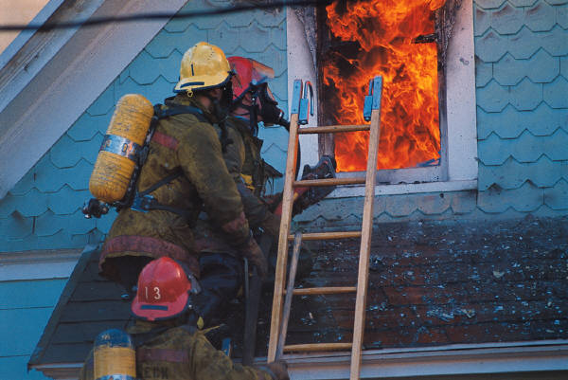
Climax
Turning Point: Describe in 10 words or less the event where the plot took the story in another direction.
May also be the event that involves the moment of greatest tension or crisis.

Slide 6
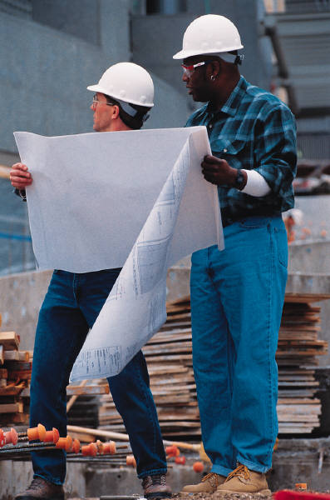
Falling Action
Minor plot developments are resolved
Describe the even in 10 words or less

Slide 7
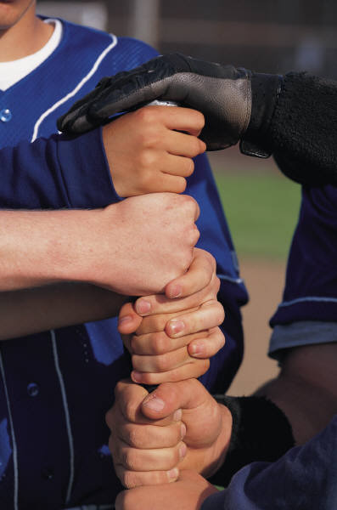
Resolution
Main conflict is resolved
Describe the event in 10 words or less
The resolution must involve the protagonist or it isn’t the resolution!

Slide 8
Directions!!!!
Create a chart just like the one on slide 2.
Follow the directions for each individual aspect of Plot/Dramatic Structure by giving all the needed information explained on each slide.
You will either do it in you Literature Learning Log or on unlined paper.
Must be colorful!
Be creative! (Draw images or pictures) Do your best work!

